Slide 1
ACCELERATE RESPONSIBLY: BUILDING AND DEPLOYING AI AGENTS

Slide 2
THE pIVOT POINT
Using AI Agents ≠ Using AI Tools
The moment you build and deploy an AI Agent, you are no longer a "user". You become responsible for all the actions taken by the AI Agent.

Slide 3
Consumer Platforms Vs. Personal Deployment
Consumer Platforms
Hide cost behind economics of scale
Aborb many mistakes and liabilities of the users
Prevent runaway behavior with tested and maintained processes
Agents and APIs
Charge per token/action, including hidden internal reasoning chains
Will revert to literal translation of communications
Optimize for what the model's understanding of "success" is and continue acting until completion or the user explicitly stops them

Slide 4
INTELLIGENCE INVOLVES COST
All of these spend money for token usage:
Prompts (your input)
Retries (if the agent fails and decides to try again)
Loops (internal reasoning chains with no completion)
Tool calls (includes all actions taken outside of the terminal, including internat browsing)
Unexpected bills mean that there were:
No scoped limits to defined actions allowed
No documented processes for the AI agent to follow
No stop conditions
No human checkpoints
THESE ARE ISSUES WITH INITIAL DEPLOYMENT DESIGN. NOT BAD LUCK.

Slide 5
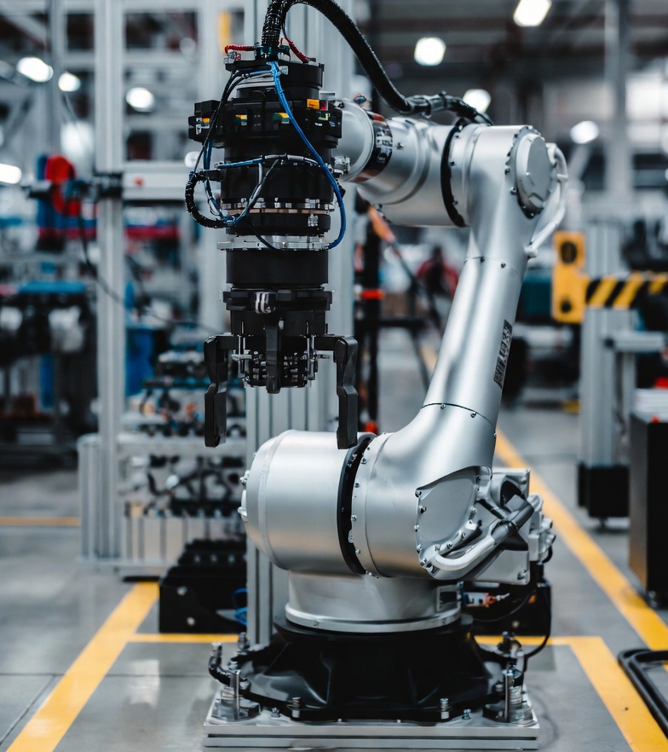
AGENTIC ACTIVITY NEEDS BOUNDARIES
Just like for robotics, AI agents need:
Defined instructions and processes
Explicit goals and forbidden actions
Testing pre-deployment, post-deployment, emergency procedures, and exit strategies
Without these, AI agents will pattern-match for best fit operations for vague deliverables.

Slide 6
MINIMUM RESPONSIBILITY POSTURE
Before deploying an agent, define:
What it can and cannot do
When the human user steps back in
How to stop it
Who reviews outcomes
Basic adversarial analyses
Who owns the cost
You don't need permission to build, but you will need to own the outcome.

Slide 7

Thank you
Charlotte Wilborn Charlotte@AIQGate.com
Document Title: AI Literacy – Accelerate Responsibly – Building and Deploying AI Agents
Version 1.0
Revision Date | Revision Summary
02.03.2026 | Created PPT/PDF for generalized use.
AI Disclosure Statement:​ This document was generated through human-AI collaboration with the use of ChatGPT/Claude/Grok. All content has been reviewed for alignment with NIST RMF and ISO 42001 standards in compliance with current AI data governance as of 02/03/2026.

